Slide 1
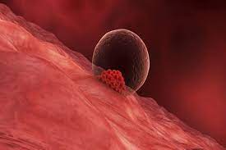
Implantation and Immunity
Homayoun Moghavemi
Obstetrician &Gynecologist
1402/6/15

Slide 2
ITEMS
Endometrium Preparation
Implantation
Why fetus is not rejected

Slide 3
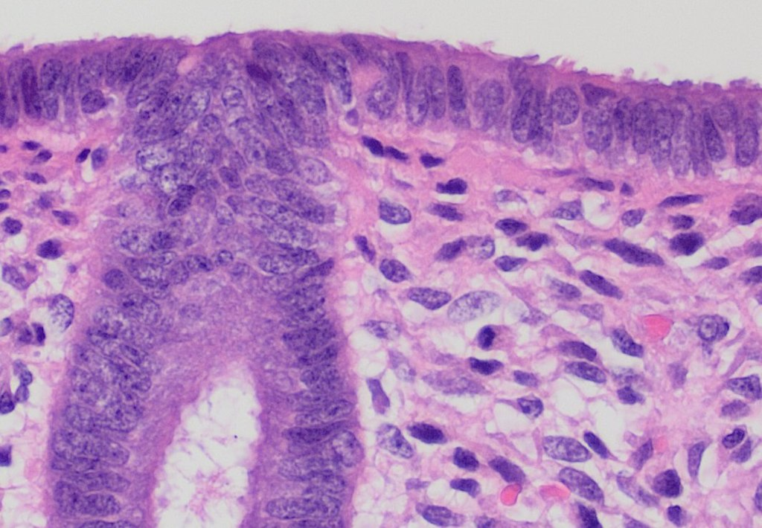
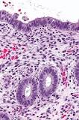

Slide 4
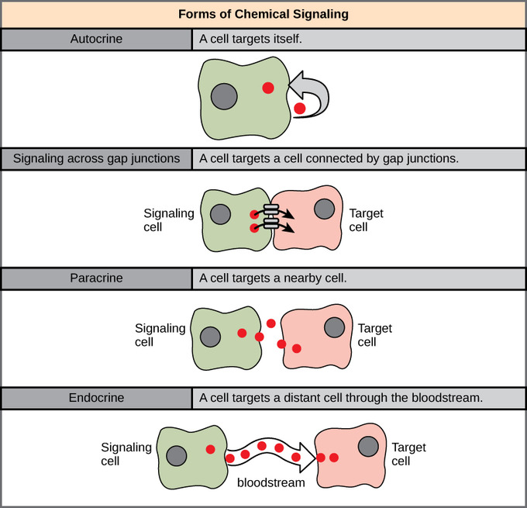
Molecular Dialogue

Slide 5
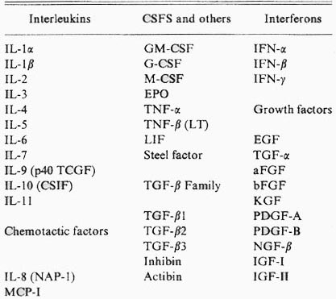
Group of cytokines (500?)
Transforming Growth Factor-β
(CSF)s
Colony-stimulating factors
20,000 protein coding genes, which are expressed in human cells.
70% of these are found within a normal endometrium

Slide 6
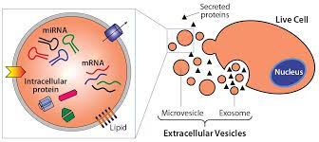

Slide 7
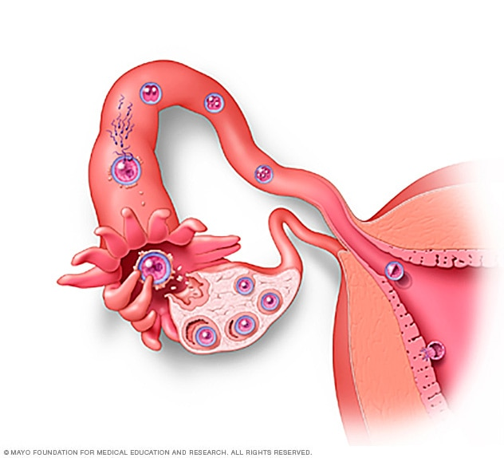
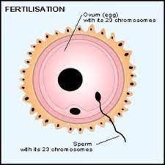
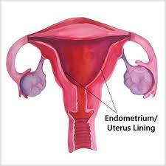
Early pregnancy factor, which is detectable in maternal blood within 36 to 48 hours after fertilization, is an immunosuppressant and is postulated to provide immunological protection to the embryo.
EPF

Slide 8
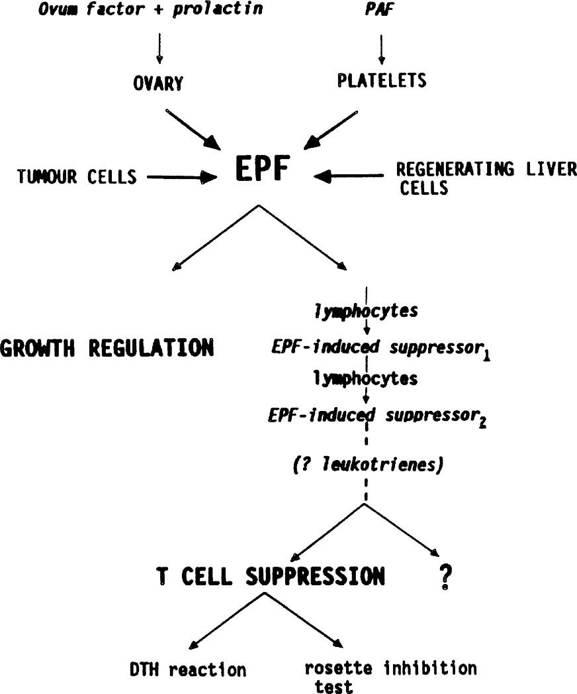

Slide 9
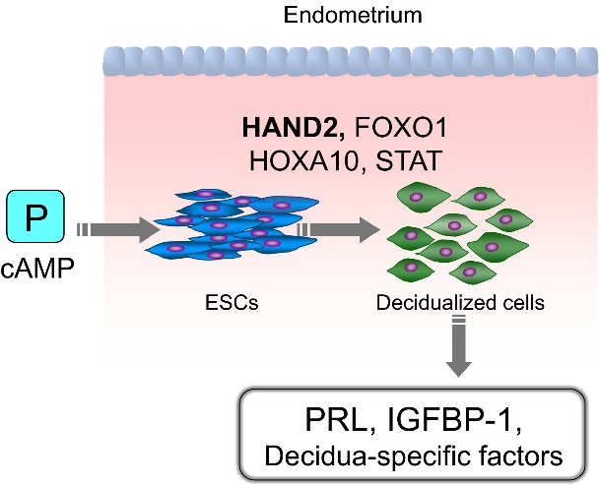
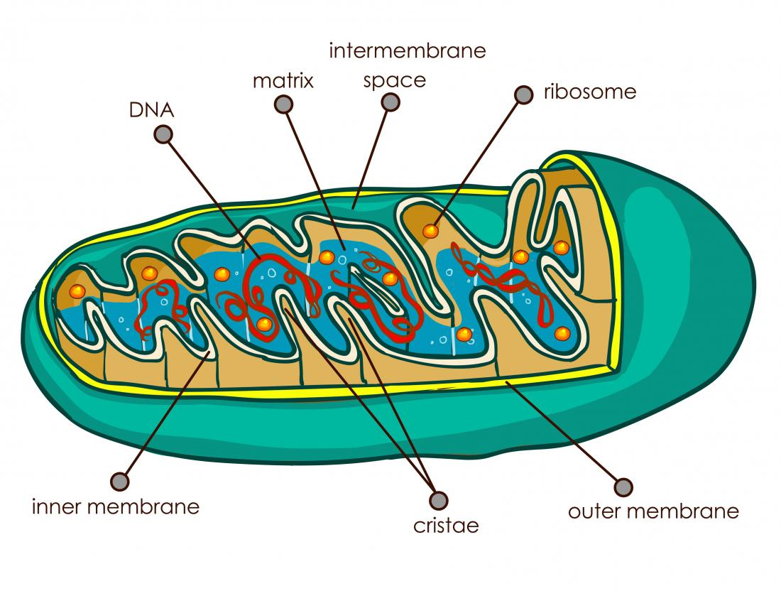
Decidualization
Angiogenesis factor—cytokines

Slide 10
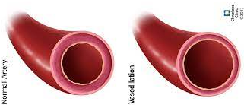
P Stromal cell Decidual cell
P
Endometrial vessel
PE2 + EVGF
Prolactin
Relaxin
Renin
IGFBP
ILGF
PE2

Slide 11
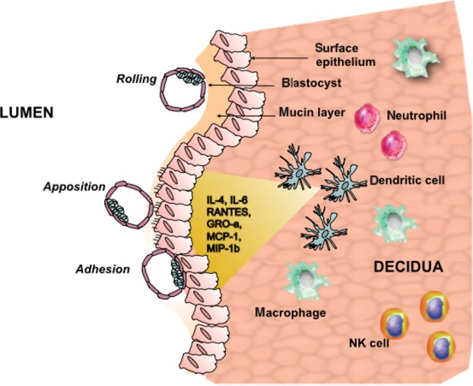
The Role of Inflammation for a Successful Implantation
E2

Slide 12
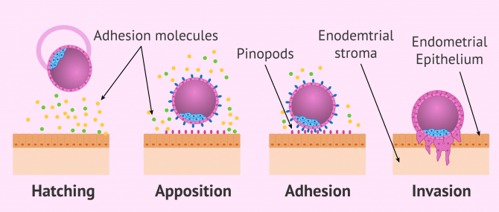

Slide 13
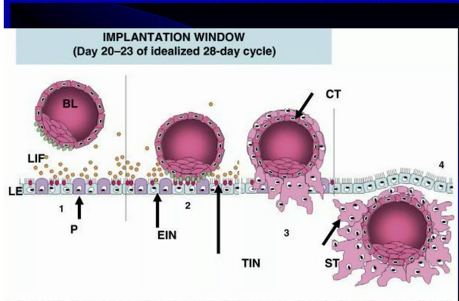

Slide 14
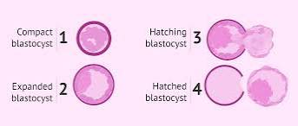
Hatching
( Lysosomal zona breaker )

Slide 15
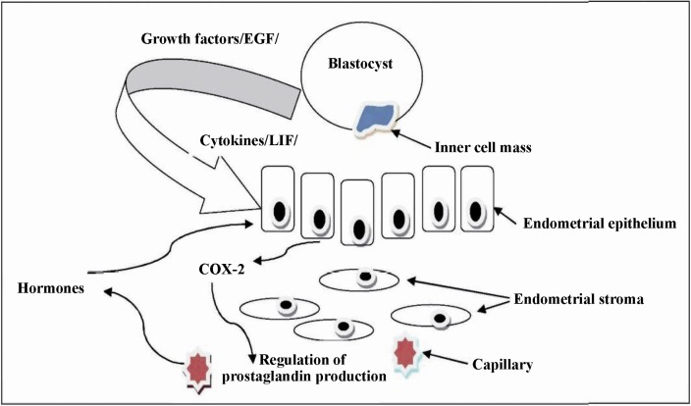

Slide 16
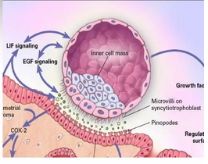
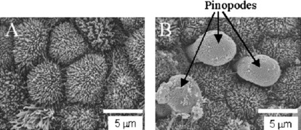

Slide 17
Decidual cell
(Cytokins)
LIF +IL11
(Adhesion factor)
Laminin-fibronectin

Slide 18
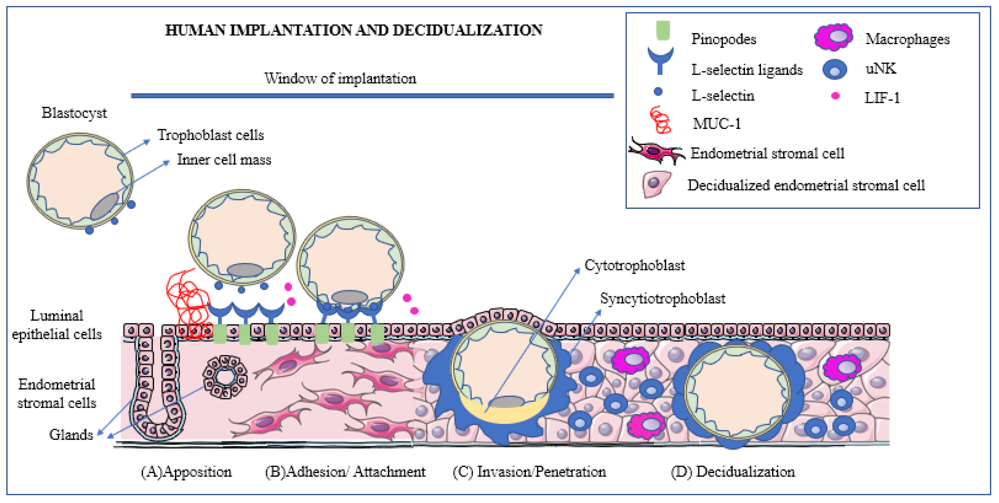
Integrins, Cadherins, Selectins

Slide 19
Invasion of Trophoblast are regulated by:
Cytokines
Chemokines
Extracellular matrix (ECM)-degrading enzymes
Membrane-bound cell surface peptidases
Placental oxygen
tension
Growth factors
Collagenase, Gelatinase, Stromelysins
( MMPs )

Slide 20
Th(CD4)
Cytokinase
Th1
Th17
vascular remodeling
Trophoblast invasion
IFNgama IL-17

Slide 21
M1
TNFα
Stromal cell
Placental Migration and invasion
IL17

Slide 22
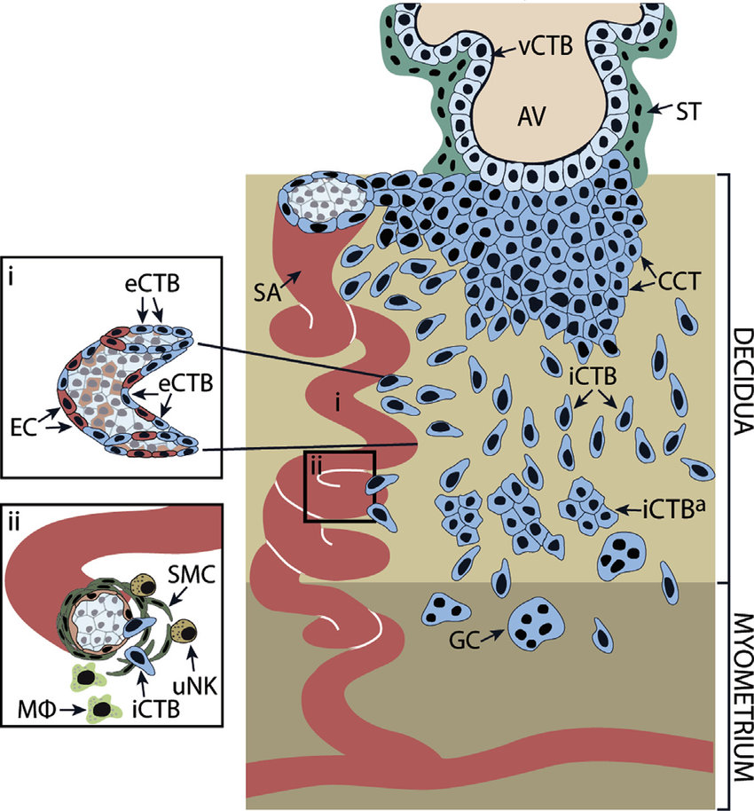
Extravilous trophoblast

Slide 23
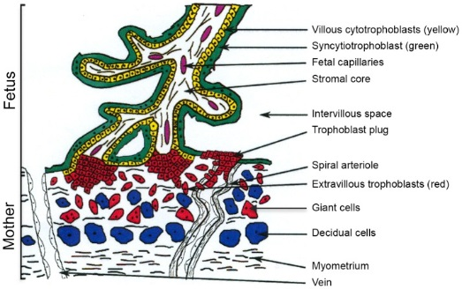
Pluging of spiral arteries

Slide 24
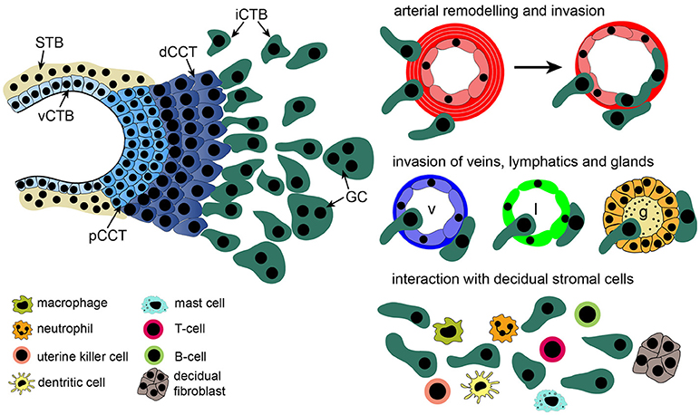

Slide 25
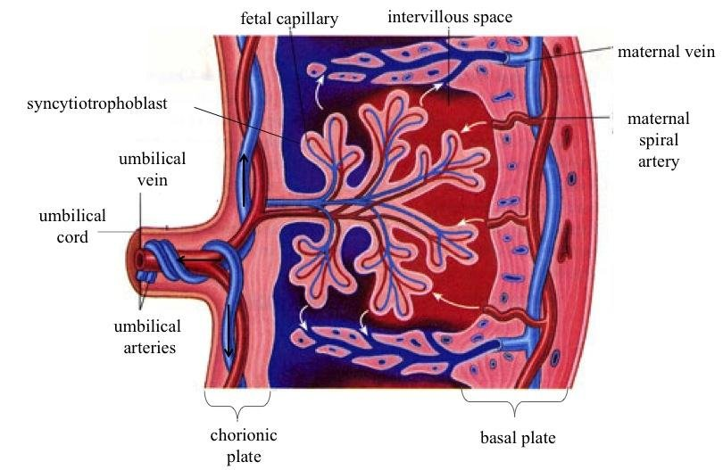

Slide 26
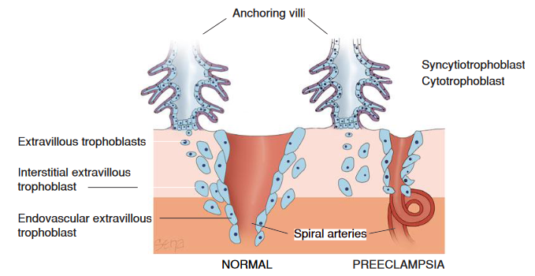

Slide 27
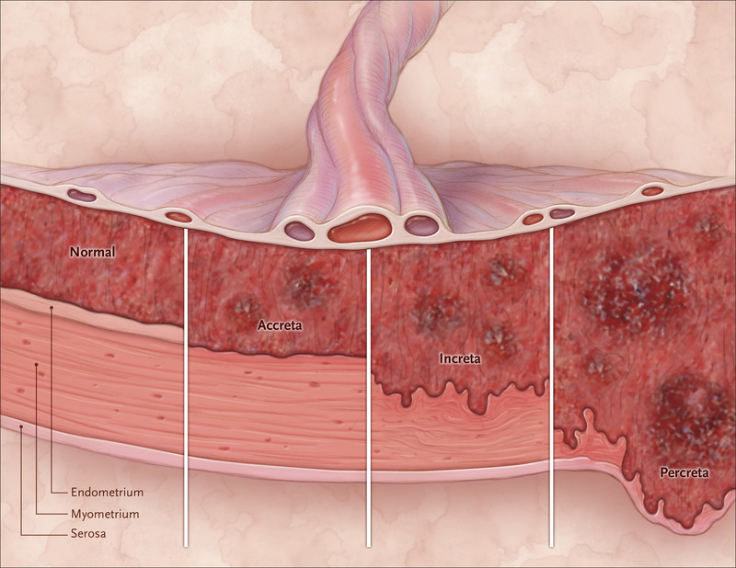

Slide 28
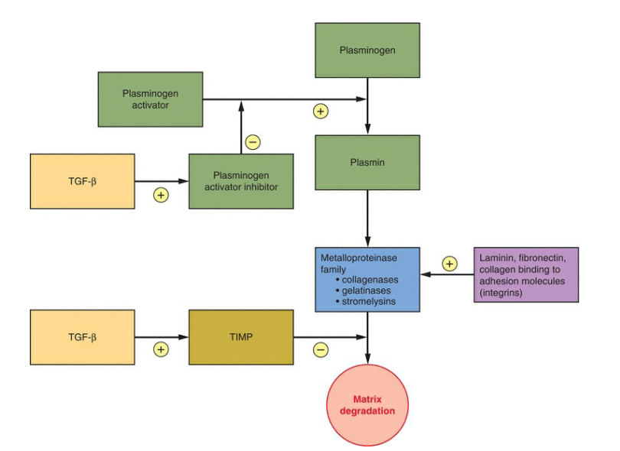
TGF=transforming growth factor
Dr HM
HCG
---
Stromal cell +-leukocyte
TIMP=Tissue inhibitor of MMP

Slide 29
Why the fetus is not rejected by his mother's immune system?

Slide 30
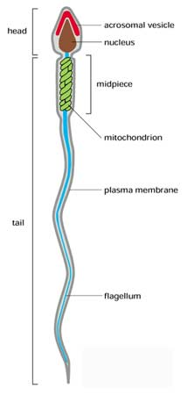
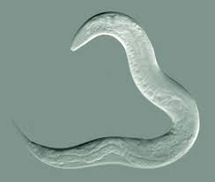
Why the fetus is not rejected
Hiding-Syncicial ccells
Neurokinin
Covering(masking)-{ eutherian fetoembryonic defense system (eu-FEDS) hypothesis. (Glycoproteins)
Immunosuppression .
MHC.

Slide 31
Decidual cell
LIF
TNF
iIL-6
IL-15
chemokines
Immune cell

Slide 32
Dentritic cell
IL10
T Cell
T reg

Slide 33
P
STROMAL CELL
IL-15
prolactin
U-NKC infiltration

Slide 34
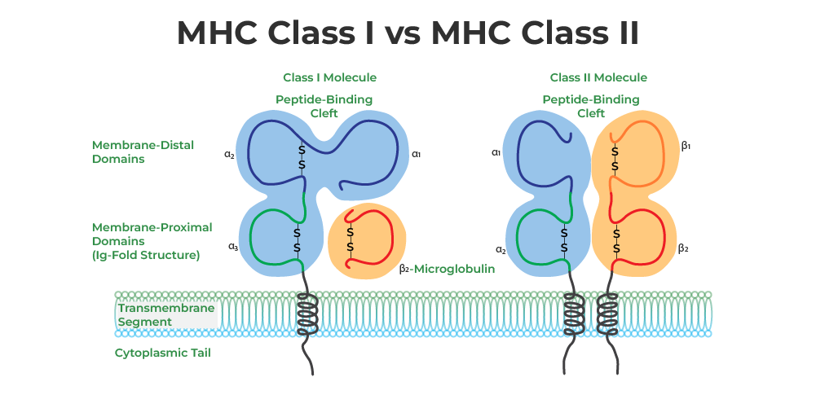

Slide 35
What is the ERA Test?
(Endometrial Receptivity Array )
The technique evaluates the womb lining by analysing 236 genes involved in its receptivity.
These genes were identified by scientific research as being important for implantation.
ERA testing is an add-on and costs £1325

Slide 36


